Slide 1
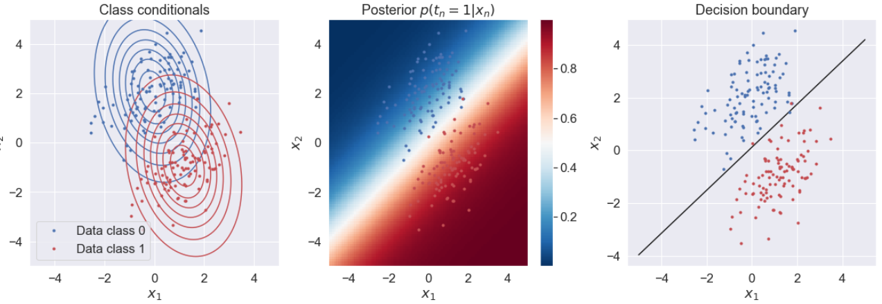
Generative vs Discriminative
 | Generative model | Discriminative model
Goal | Estimate class conditionals | Everything together
What’s learned | Probability distribution | Decision boundary

Slide 2
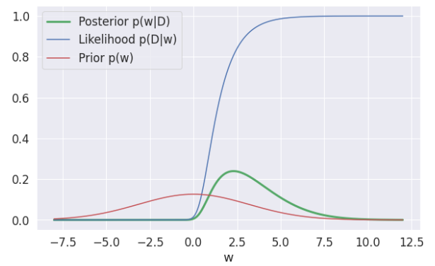


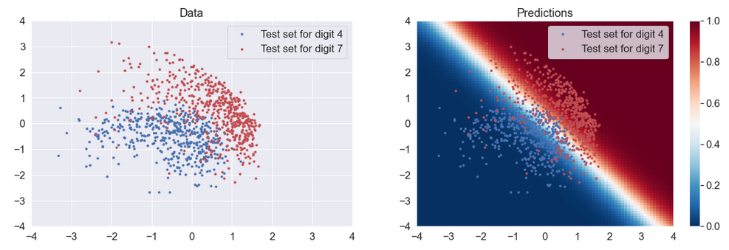
Bayesian Logistic Regression
Likelihood:
Prior:

Slide 3
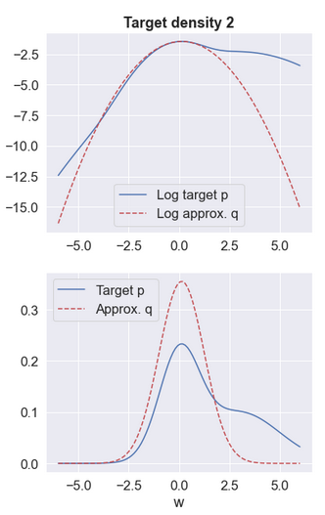
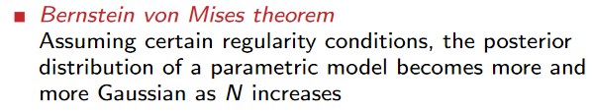




Laplace Approximation
Posterior:
Marginal Likelihood:

